Slide 1
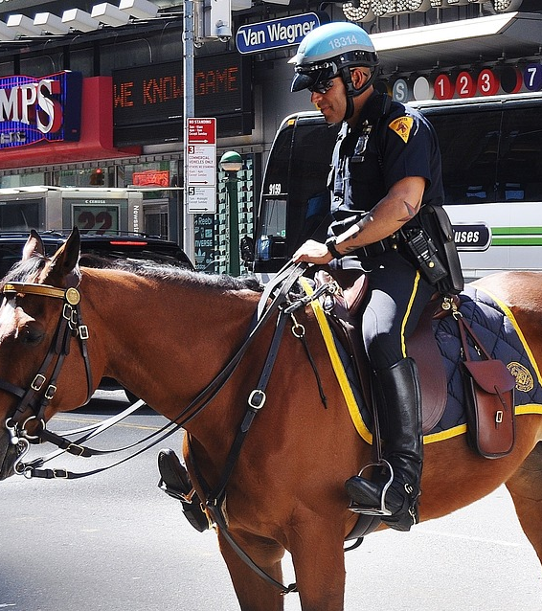
Analysis of Fatal Death Cause by Police Force
BY Adam CHEN JINGHAO
Personal Website
Email
Course project: 100 Days of Code: The Complete Python Pro Bootcamp for 2023

Slide 2
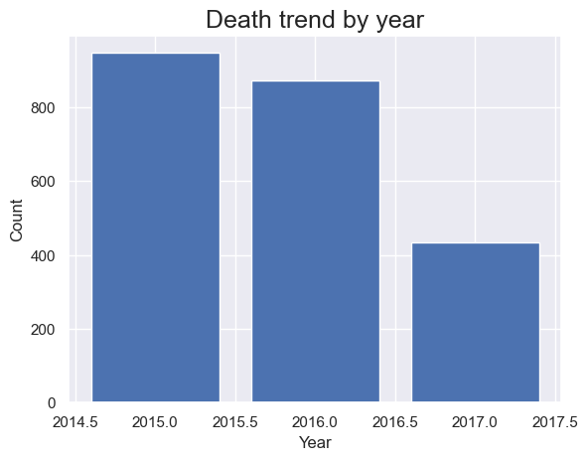
Based on the data, here are some findings:
The number of deaths decreased significantly in 2017 compared to both 2016 and 2015.
The course provided all the data.
To view the latest data, click here.

Slide 3
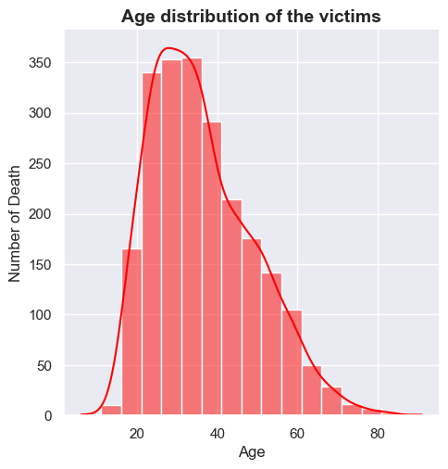
Based on the data, here are some findings:
The number of deaths decreased significantly in 2017 compared to 2016 and 2015.
The average age of suspects killed was 36, and the younger and oldest victim was 6 and 91, respectively. Most of the victims were killed between the age of 24 to 48.
count 2254
mean 36.2
std 12.8
min 6.0
25% 26.0
50% 34.0
75% 45.0
max 91.0
The course provided all the data.
To view the latest data, click here.

Slide 4
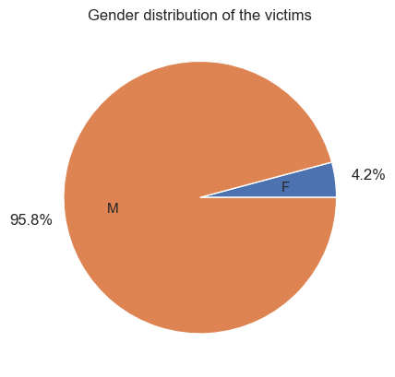
Based on the data, here are some findings:
The number of deaths decreased significantly in 2017 compared to 2016 and 2015.
The average age of suspects killed was 36, and the younger and oldest victim was 6 and 91, respectively. Most of the victims were killed between the age of 24 to 48.
Nearly 96% of the victims are male.

Slide 5
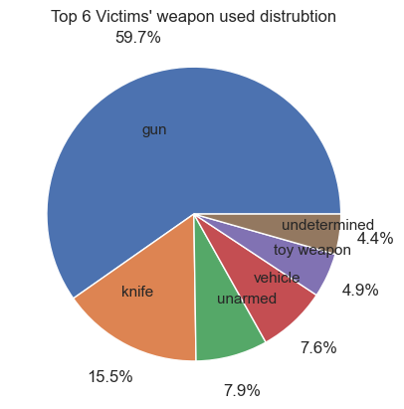
Based on the data, here are some findings:
The number of deaths decreased significantly (nearly half) in 2017 compared to 2016 and 2015.
The average age of suspects killed was 36, and the younger and oldest victim was 6 and 91, respectively. Most of the victims were killed between the age of 24 to 48.
Nearly 96% of the victims are male.
82.6% of the victims were holding life-threatening objects. While, there are 17.2% of the victims were unarmed, carrying toy weapons or undetermined objects.

Slide 6
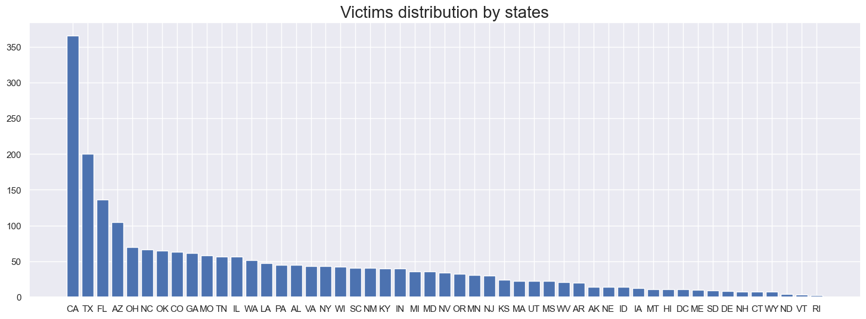
Based on the data, here are some findings:
The number of deaths decreased significantly (nearly half) in 2017 compared to 2016 and 2015.
The average age of suspects killed was 36, and the younger and oldest victim was 6 and 91, respectively. Most of the victims were killed between the age of 24 to 48.
Nearly 96% of the victims are male.
82.6% of the victims were holding life-threatening objects. While, there are 17.2% of the victims were unarmed, carrying toy weapons or undetermined objects.
California has the highest number of victims, significantly higher than the rest of the states. Followed by Texas and Florida state.
count 51.0
mean 44.1
std 57.7
min 2.0
25% 13.0
50% 34.0
75% 49.0
max 366.0

Slide 7
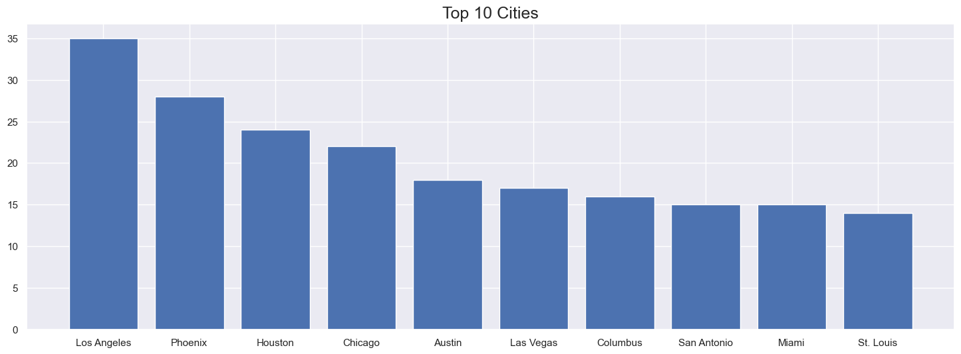
Based on the data, here are some findings:
The number of deaths decreased significantly (nearly half) in 2017 compared to 2016 and 2015.
The average age of suspects killed was 36, and the younger and oldest victim was 6 and 91, respectively. Most of the victims were killed between the age of 24 to 48.
Nearly 96% of the victims are male.
82.6% of the victims were holding life-threatening objects. While, there are 17.2% of the victims were unarmed, carrying toy weapons or undetermined objects.
California has the highest number of victims, significantly higher than the rest of the states. Followed by Texas and Florida state.
Los Angeles City was on the top of the list, with 35 victims killed by police force. However, there were three cities of the Texas State on the list.
Top 10 Cities
Los Angeles CA 35
Phoenix AZ 28
Houston TX 23
Chicago IL 22
Las Vegas NV 17
Austin TX 16
San Antonio TX 15
Columbus OH 14
Indianapolis IN 14
St. Louis MO 14

Slide 8
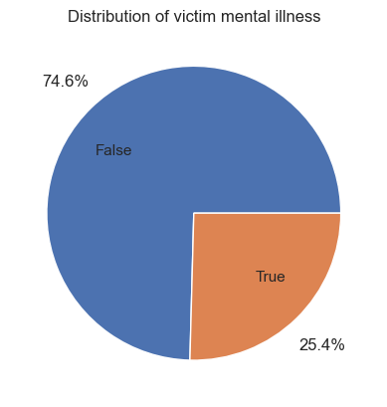
Based on the data, here are some findings:
The number of deaths decreased significantly (nearly half) in 2017 compared to 2016 and 2015.
The average age of suspects killed was 36, and the younger and oldest victim was 6 and 91, respectively. Most of the victims were killed between the age of 24 to 48.
Nearly 96% of the victims are male.
82.6% of the victims were holding life-threatening objects. While, there are 17.2% of the victims were unarmed, carrying toy weapons or undetermined objects.
California has the highest number of victims, significantly higher than the rest of the states. Followed by Texas and Florida state.
Los Angeles City was on the top of the list, with 35 victims killed by police force. However, there were three cities of the Texas State on the list.
¼ of the victims were later found to have mental issues.

Slide 9
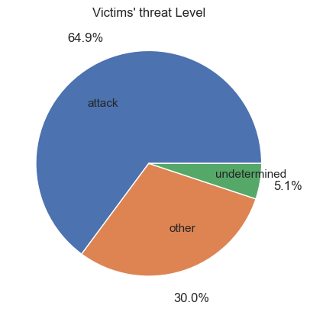
Based on the data, here are some findings:
The number of deaths decreased significantly (nearly half) in 2017 compared to 2016 and 2015.
The average age of suspects killed was 36, and the younger and oldest victim was 6 and 91, respectively. Most of the victims were killed between the age of 24 to 48.
Nearly 96% of the victims are male.
82.6% of the victims were holding life-threatening objects. While, there are 17.2% of the victims were unarmed, carrying toy weapons or undetermined objects.
California has the highest number of victims, significantly higher than the rest of the states. Followed by Texas and Florida state.
Los Angeles City was on the top of the list, with 35 victims killed by police force. However, there were three cities of the Texas State on the list.
¼ of the victims were later found to have mental issues.
64.9% of victims attacked the police officers

Slide 10
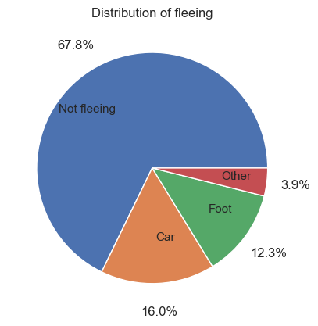
Based on the data, here are some findings:
The number of deaths decreased significantly (nearly half) in 2017 compared to 2016 and 2015.
The average age of suspects killed was 36, and the younger and oldest victim was 6 and 91, respectively. Most of the victims were killed between the age of 24 to 48.
Nearly 96% of the victims are male.
82.6% of the victims were holding life-threatening objects. While, there are 17.2% of the victims were unarmed, carrying toy weapons or undetermined objects.
California has the highest number of victims, significantly higher than the rest of the states. Followed by Texas and Florida state.
Los Angeles City was on the top of the list, with 35 victims killed by police force. However, there were three cities of the Texas State on the list.
¼ of the victims were later found to have mental issues.
64.9% of victims attacked the police officers
Nearly 70% of the victims are not fleeing. They either choose to fight back or surrender.

Slide 11
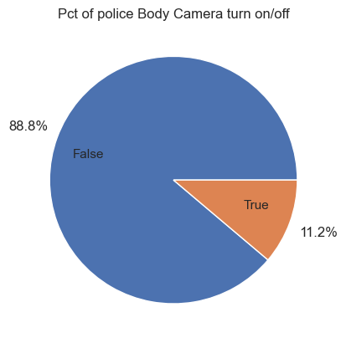
Based on the data, here are some findings:
The number of deaths decreased significantly (nearly half) in 2017 compared to 2016 and 2015.
The average age of suspects killed was 36, and the younger and oldest victim was 6 and 91, respectively. Most of the victims were killed between the age of 24 to 48.
Nearly 96% of the victims are male.
82.6% of the victims were holding life-threatening objects. While, there are 17.2% of the victims were unarmed, carrying toy weapons or undetermined objects.
California has the highest number of victims, significantly higher than the rest of the states. Followed by Texas and Florida state.
Los Angeles City was on the top of the list, with 35 victims killed by police force. However, there were three cities of the Texas State on the list.
¼ of the victims were later found to have mental issues.
64.9% of victims attacked the police officers
Nearly 70% of the victims are not fleeing. They either choose to fight back or surrender.
Only 11.2% of the police body cameras were turned on during the shooting.

Slide 12
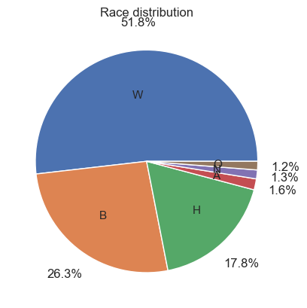
Based on the data, here are some findings:
The number of deaths decreased significantly (nearly half) in 2017 compared to 2016 and 2015.
The average age of suspects killed was 36, and the younger and oldest victim was 6 and 91, respectively. Most of the victims were killed between the age of 24 to 48.
Nearly 96% of the victims are male.
82.6% of the victims were holding life-threatening objects. While, there are 17.2% of the victims were unarmed, carrying toy weapons or undetermined objects.
California has the highest number of victims, significantly higher than the rest of the states. Followed by Texas and Florida state.
Los Angeles City was on the top of the list, with 35 victims killed by police force. However, there were three cities of the Texas State on the list.
¼ of the victims were later found to have mental issues.
64.9% of victims attacked the police officers
Nearly 70% of the victims are not fleeing. They either choose to fight back or surrender.
Only 11.2% of the police body cameras were turned on during the shooting.
White victims were taken more than half, while Black and Hispanic victims account for 26.3% and 17.8%， respectively.

Slide 13
From the above findings, we can observe that:
There is a significant proportion of the male victims with no mental issues, aged between 24 and 48, with life-threatening objects attacking the police officers. California, Texas, and Florida state have way too many victims compared to the rest of the country.
However, there is also a noticeable portion of the victim’s life can be saved if there are specific prevention procedures/policies in place.
This analysis aims to identify potential causes of deaths and ways to reduce them.

Slide 14
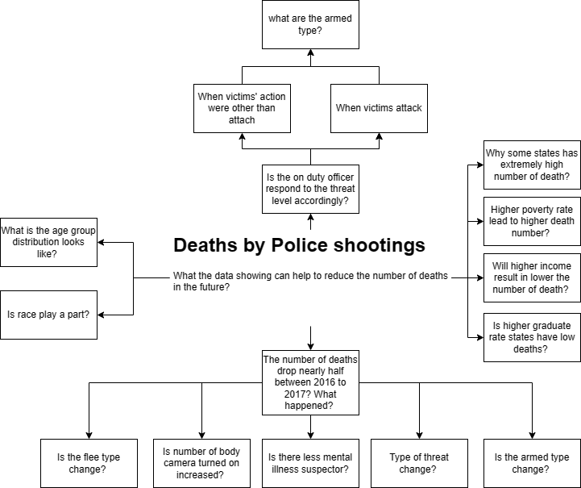

The plan is to address the question.
**Click the box to view the diagrams.
Conclusion

Slide 15
Why did the deaths decrease by almost half in 2017 compared to 2015 and 2016?
Does the number of times that police officers turn on contribute to that?
No related. Figure
Is it because there are fewer non-mental illness victims?
Yes! Non-mental illness victims dropped disproportional in 2017. Figure
Has the armed type changed over the period?
Nothing significant. Figure
Has the threat level changed?
No. Figure
Is the flee type change?
No. Figure
Go back

Slide 16
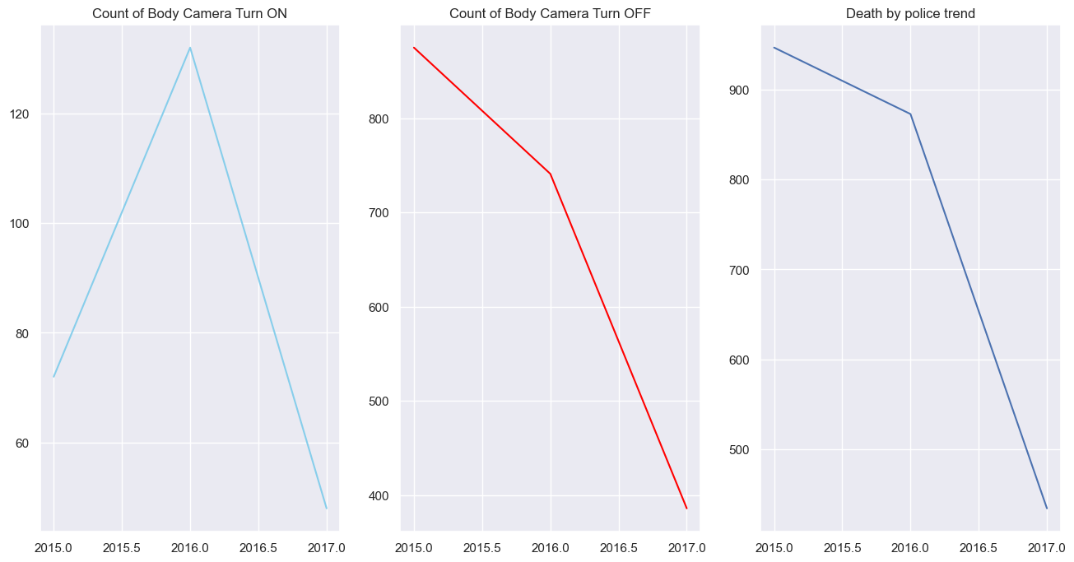
Data from 2015 to 2017 indicates a decrease in the number of activated body cameras. However, the number of victims has continued to decline.
Go back

Slide 17
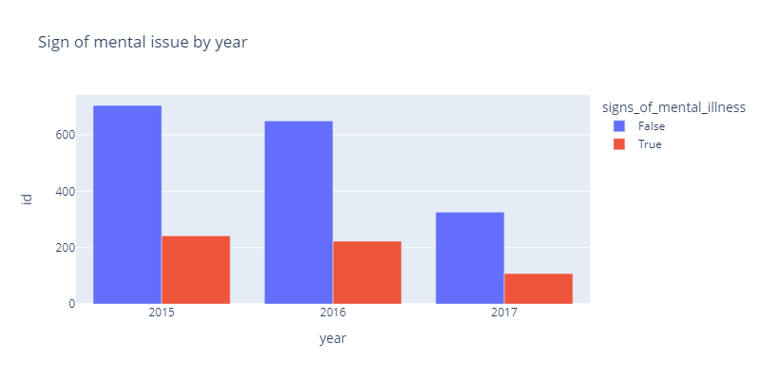
In the year 2017, Non-mental illness victims dropped disproportional.
Go back

Slide 18
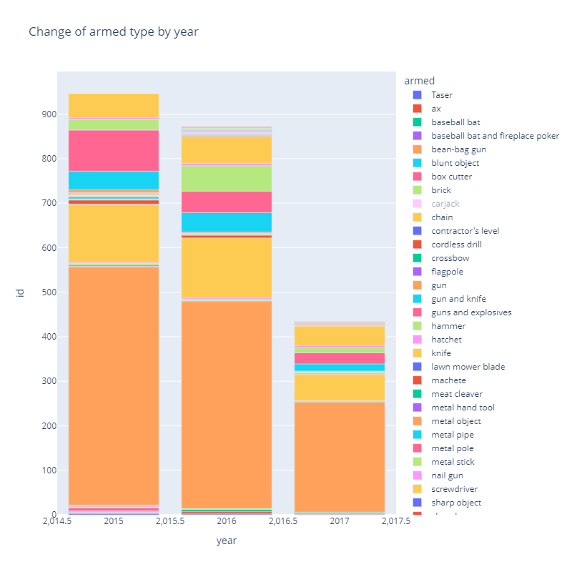
Guns, knives and vehicles are still the primary weapons of the victims.
Go back

Slide 19
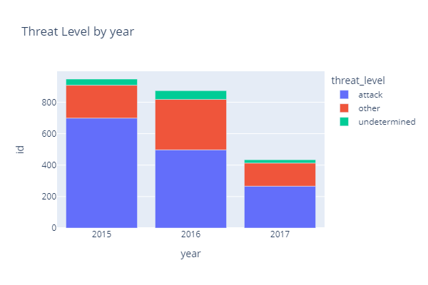
Go back

Slide 20
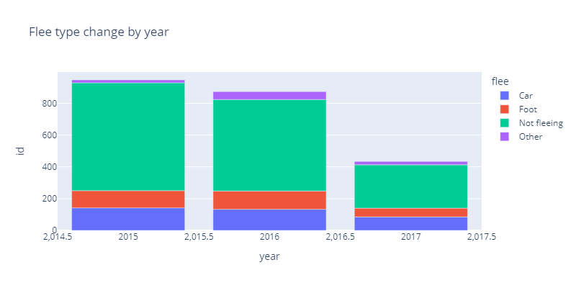
Go back

Slide 21
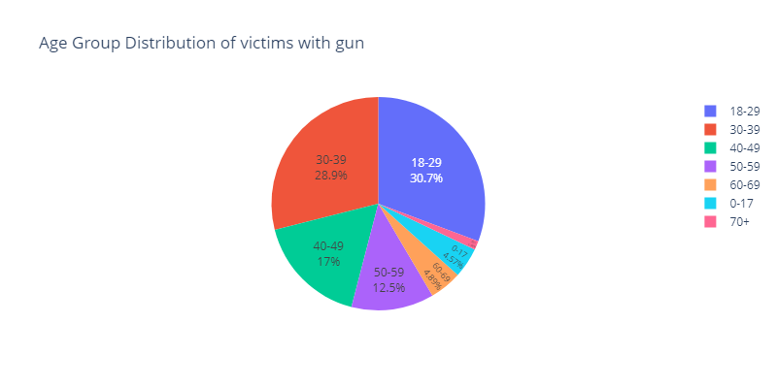
Under-age victims accounted for 4.57%, and they are not supposed to have access to fire weapons by U.S. law.
Victims aged 18-39 accounted for 59.6% of the total cases.
What if we move the legal age to 21?

Slide 22
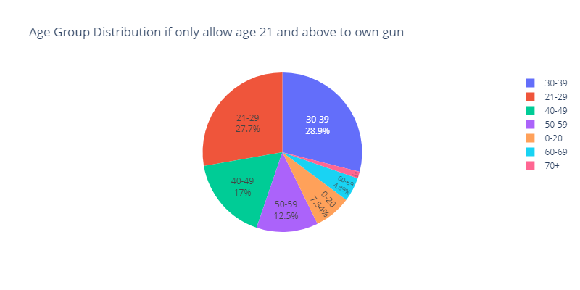
Under-age victims accounted for 7.54% and victims aged 21-39 portion will lower to 56.6%.
Go back
Back to Conclusion

Slide 23
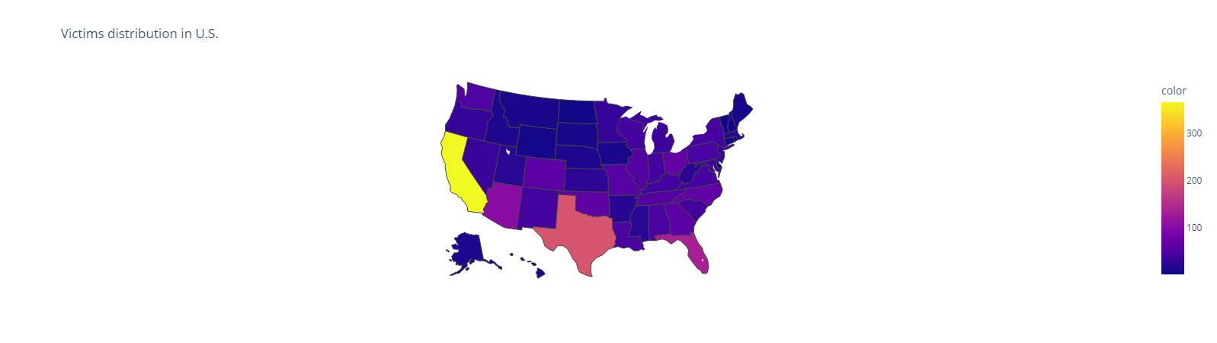
All of California, Texas, Florida, and Arizona are connected by land or close to South America.
Since we all heard about drug cartels from South America in Hollywood movies, and consuming drugs will cause mental issues, let us check out the victims with mental issues by state.
Back to Conclusion

Slide 24
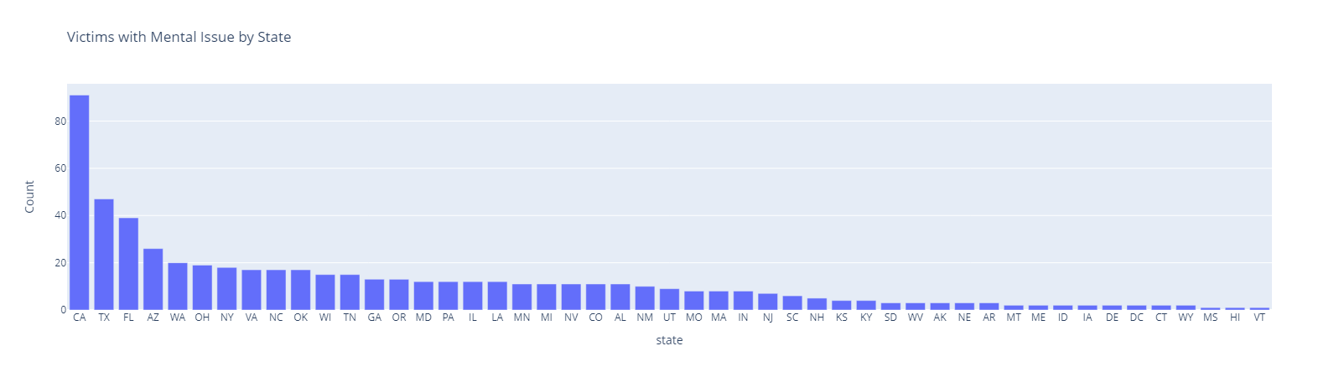
California, Texas, Florida, and Arizona State have significantly higher numbers of victims with mental issues
Go back

Slide 25
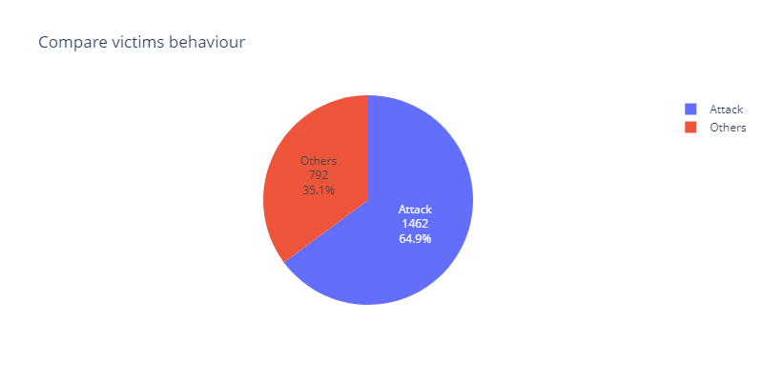
35.1% of victims were showing behaviour other than attack.

Slide 26
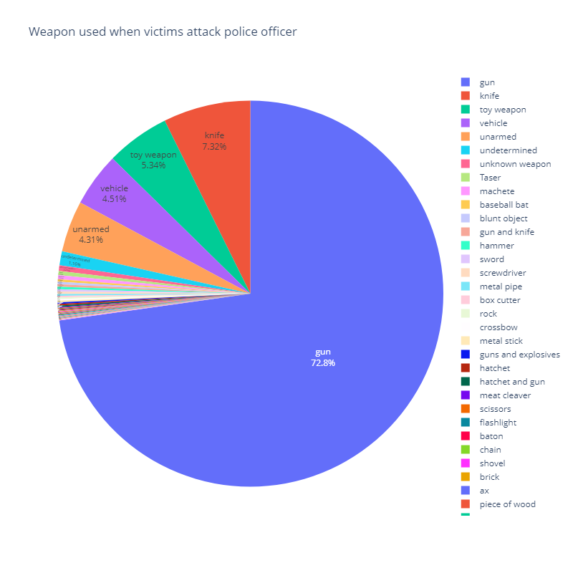
72.8% of victims who tried to attack police offices were armed with guns.

Slide 27
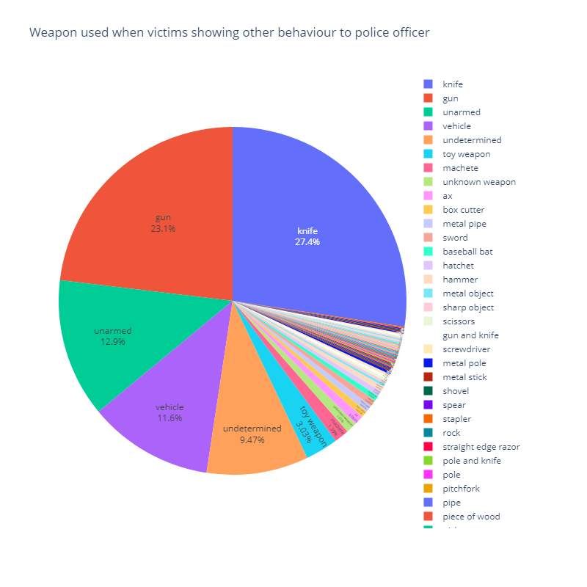
With no attack behaviour victims, the number of victims armed with guns was reduced by nearly 50%.
At the same time, knife-armed victims increased by 20%. As well, it is clear to observe other sections also raise proportionally.
Go back

Slide 28
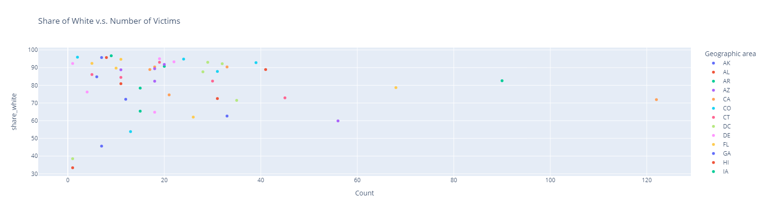
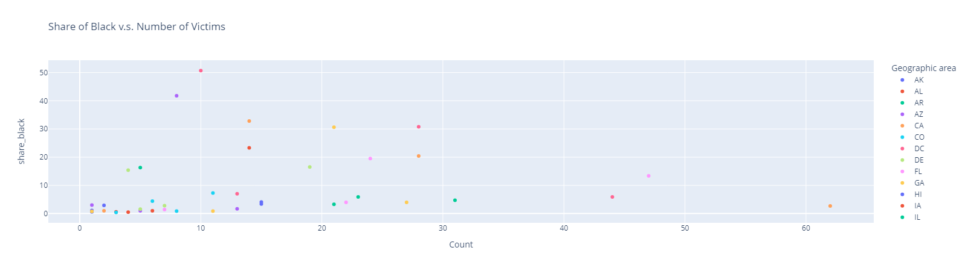
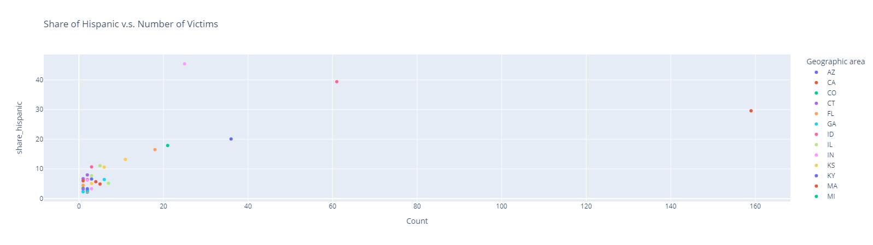
There is no correlation between the race percentage and the number of victims.
Go back

Slide 29
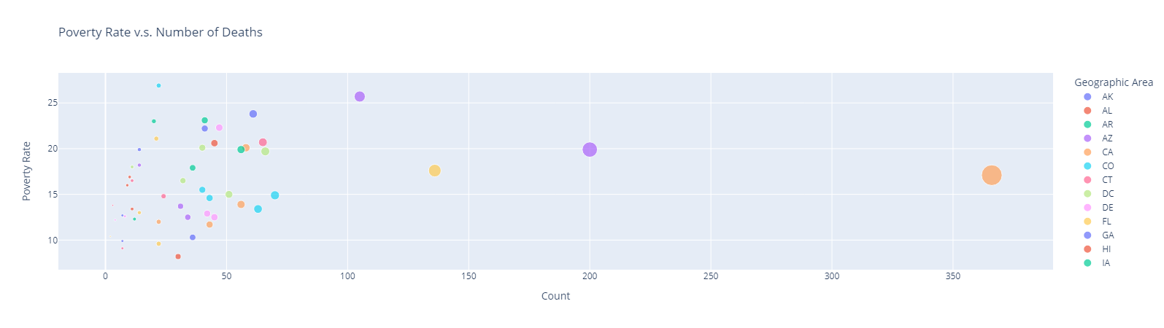
There are no correlations between the poverty rate and the number of deaths.
Go back

Slide 30
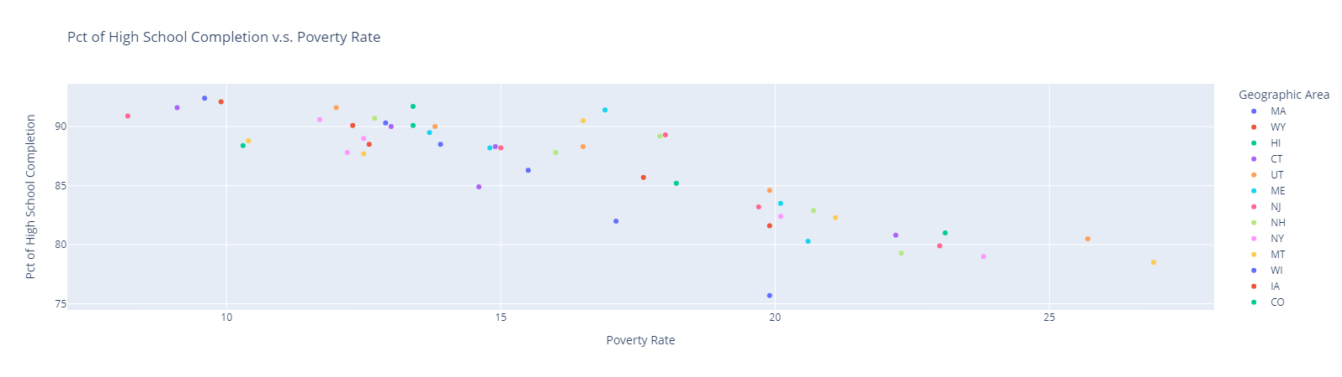
A higher percentage of people who have completed high school can reduce poverty.
Go back

Slide 31
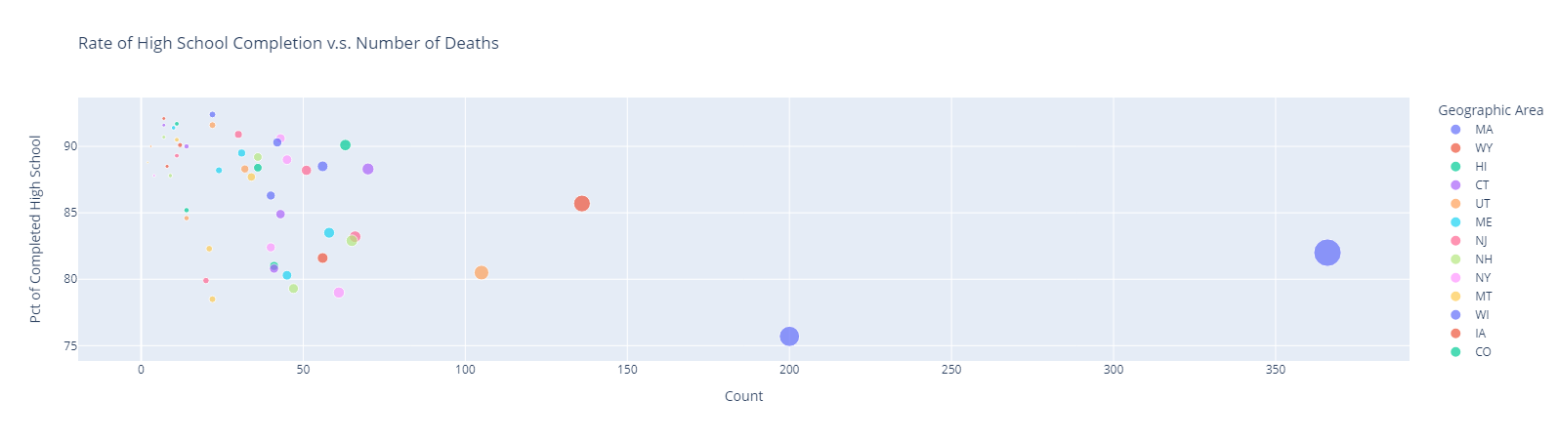
No clear pattern shows that a higher high school completion rate will lower the death rate.
Go back

Slide 32
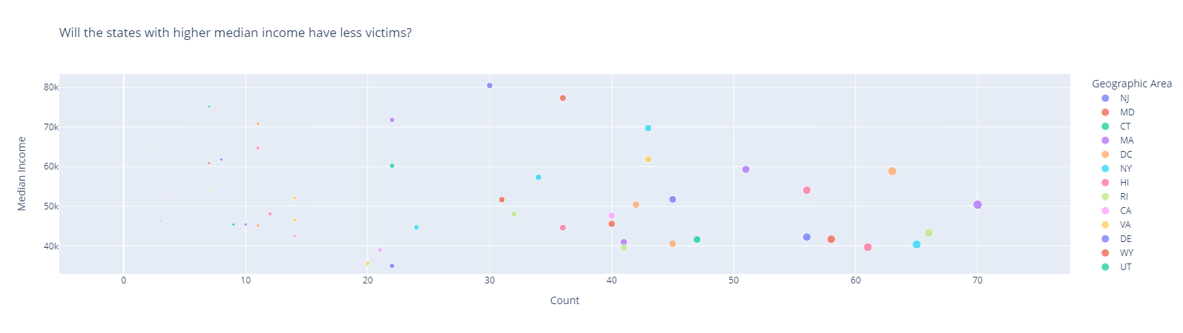
Will the states with higher median income have fewer victims?
Go back

Slide 33
Conclusion
California, Texas, Florida, and Arizona have more cases than the other states. They are all located in the country’s southern region or near South America. This may suggest that a tight border control measure is required to prevent illegal weapons from sneaking into the countries. [Figure]
If the lawmakers implement stronger procedures to limit access to weapons for unqualified personnel or minors. This may include pushing the legal age of holding a gun to 21 years old[Figure] or stricter requirements to store weapons.
Provide better protection gear or equipment for police officers, such as longer-range stun guns. This may help to reduce the number of knife-armed victims and other undetermined situations.
Toy companies should be banned from producing toy guns modelled after real-life firearms.

